Slide 1

Scrum Method in
Software Development Industry
Sai Venkata Nikhil Sunkara

Slide 2
Tables of Contents
Scrum principles
Scrum main characteristics and processes
Scrum team members, roles of scrum team members
Sprints’ fundamentals
Scrum software engineering model
Backlogs: sprint backlogs and product backlogs
Real-world examples of Scrum method application in SD industry
Scrum method: the outcomes of your own detailed SWOT analysis
Detailed textual and graphic information on selected ONE scrum tool
References used

Slide 3
1. Scrum Principles

Slide 4
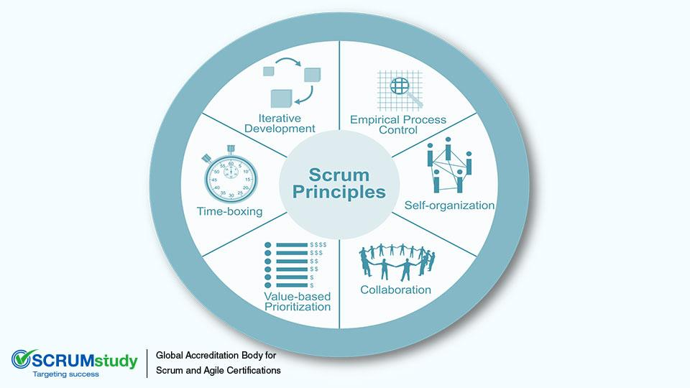
Scrum is a management and control process that cuts through complexity to focus on building software that meets business needs.
Scrum principles:
Empirical Process Control
Transparency
Inspection
Adaptation
Self-organization
Collaboration
Awareness
Articulation
Appropriation
Value Based Prioritization
Time-Boxing
Time - constraint
Iterative Development
https://www.scrumalliance.org/why-scrum/scrum-guide#sthash.7Z5Agm3N.dpuf
http://www.scrumstudy.com/scrum-principles.asp#sthash.1RegxNXS.dpuf

Slide 5
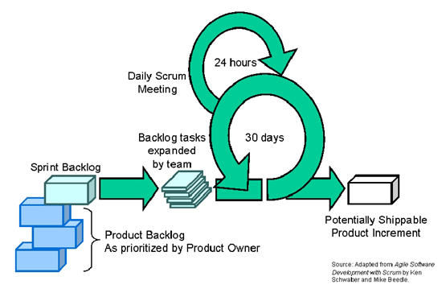
Concepts of Short Delivery Cycles
A scrum team consists of nearly 7 people
Each sprint is typically two to four weeks long
Shorter sprint cycle, team is more frequently delivering value to the business
Simple implementation
Increased productivity
http://www.agilelearninglabs.com/resources/scrum-introduction/
https://www.google.co.in/search?q=concepts+of+short+delivery+cycles+scrum&source=lnms&tbm=isch&sa=X&ved=0ahUKEwiw-9DR4PbTAhVBqo8KHXpFBeQQ_AUIBigB&biw=1366&bih=676#tbm=isch&q=+short+delivery+cycles+scrum&imgrc=bWBymN0NwocBcM:

Slide 6
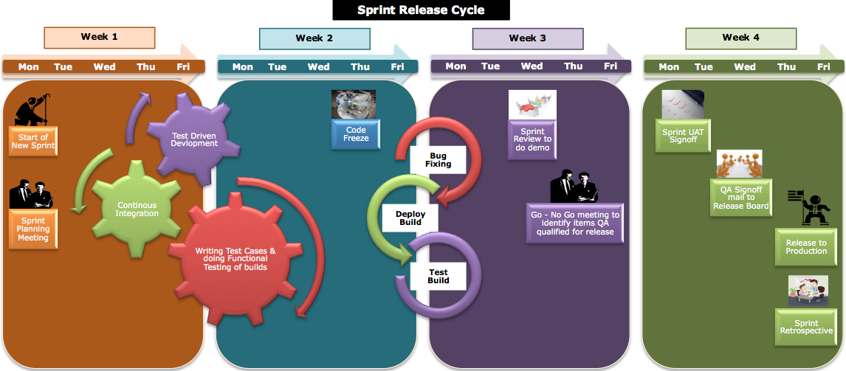
Concepts of Short Delivery Cycles (Cont.)
https://www.gevme.com/blog/mudd-marrying-ux-design-and-development

Slide 7
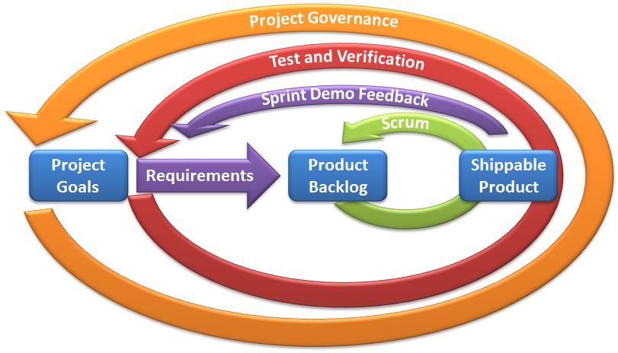
Working with Changing Requirements
Requirements transforms project goals into product backlog
Team updates the product backlog
Once sprint begins, it is not possible to add requirements to backlog
Take feedback from sprint demos into consideration
Continuous planning improves team’s chances of success
https://www.scrumalliance.org/why-scrum/core-scrum-values-roles#sthash.KAS6gd6I.dpuf

Slide 8
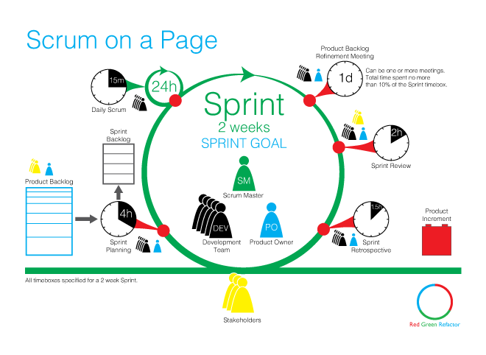
On-time and Time-boxed Iterations in SD
Timebox is defined as period of time during which a task must be accomplished. These are used to manage software development risk.
Sprint:
A time-boxed iteration, during which the scrum master protects the team from vision or scope creep that could affect the sprint goal
If a goal cannot meet the requirements then sprint is aborted abnormally and restarted from the planning point
https://blogs.msdn.microsoft.com/willy-peter_schaub/2010/04/27/basics-of-scrum-part-2-what-are-the-scrum-time-boxes-and-how-will-we-use-them-in-our-the-distributed-virtual-and-part-time-world/

Slide 9
On-time and Time-boxed Iterations in SD (Cont.)
Sprint Planning Meeting:
During the first half, the team decides what to complete during the sprint from the product backlog and defines a sprint goal
During the second half of the meeting the team decides how to complete the selected backlog items
Sprint Review:
Product owner identifies what has been done.
Team reports on what went well and what went bad during the sprint
Participants in review include Product owner, Scrum team, Scrum Master, Management, customers and developers
Team demonstrates the work done

Slide 10
On-time and Time-boxed Iterations in SD (Cont.)
Sprint Retrospective: Three hour time-boxed meeting.
Team inspects the last sprint in terms of people, process, collaboration and tools
Identify actions that can be implemented in the next sprint to improve
Daily Scrum Meeting: Time-boxed 15-minute meeting
Each member explains:
What has been accomplished since the last meeting
What will be done next before the next meeting
What any obstacles/impediments have emerged
https://blogs.msdn.microsoft.com/willy-peter_schaub/2010/04/27/basics-of-scrum-part-2-what-are-the-scrum-time-boxes-and-how-will-we-use-them-in-our-the-distributed-virtual-and-part-time-world/

Slide 11
2. Scrum Main Characteristics And Processes

Slide 12
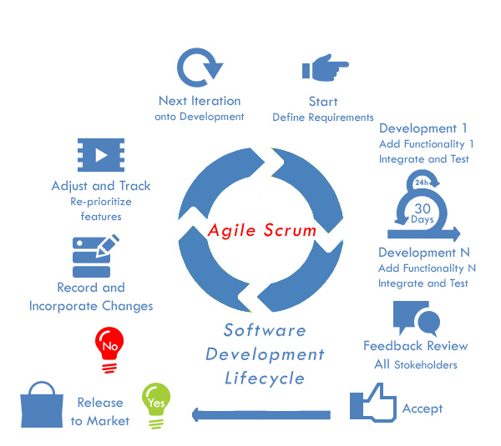
Scrum Main Characteristics And Processes
A project can start with any activity
Can change between activities at any time
Increases the project’s flexibility and productivity
No sequence is prescribed in which the Analysis, Design, Implementation and Testing activities must be implemented
Flow is linear with some iterations in the planning phase
http://www.selectbs.com/process-maturity/what-is-scrum-development

Slide 13
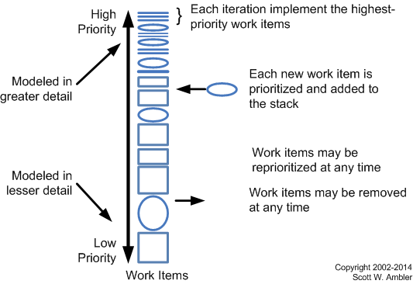
Prioritization of work and Software Development activities
Product backlogs are prioritized in terms of business value and risk
New requirements are prioritized by project stakeholders and added to stack in the appropriate place
A single person needs to be final authority when it comes to requirement prioritization
In Scrum, Disciplined Agile Delivery (DAD) adopts role in Scrum which is called product owner
Many project stakeholders, end users, managers are responsible for representing them
http://agilemodeling.com/essays/prioritizedRequirements.htm#sthash.eq7TvmrY.dpuf

Slide 14
Prioritization of work and Software Development activities (Cont.)
Flow is linear with some iterations in Planning phase
Backlog is initially filled as result of your requirement envisioning efforts at the beginning of the project
Each team pulls an iterations worth of work on top of the stack and commits to implement it by end of the iteration
Project stakeholders have the right to define new requirements, change their decisions and reprioritize them as they see it
Priorities of non-requirement works are negotiated by team with stakeholders or
Addressed as part of slack time with schedule
http://agilemodeling.com/essays/prioritizedRequirements.htm#sthash.eq7TvmrY.dpuf

Slide 15
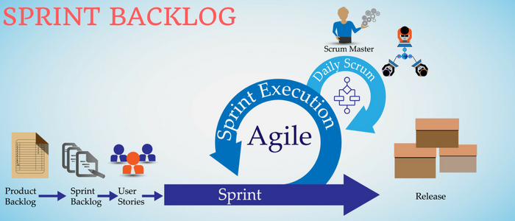
Management of Work Backlogs
Scrum Backlog:
Bugs
Technical Work
Knowledge Acquisition
Product Backlog management includes:
Product Backlog items
Ordering the items in Product Backlog to best achieve goals and missions
Optimizing the Development Team performs the value of work
Ensuring that the Product Backlog is visible, transparent and clear
http://www.softwaretestinghelp.com/agile-scrum-methodology-for-development-and-testing/

Slide 16
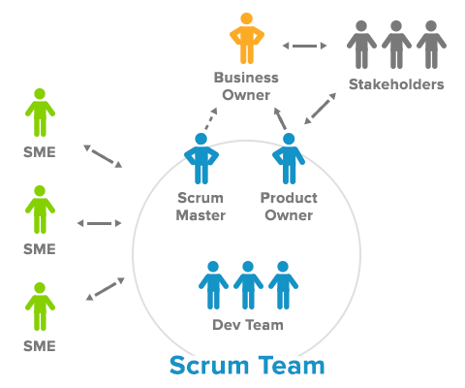
Team Working
Team members have differing skill sets and cross-train each other so no one person becomes a bottleneck in the delivery of work.
Once the team gets a business goal, it:
Figures out how to do the work
Identifies what’s getting in its way
Takes responsibility to resolve all the difficulties within its scope
Works with other parts of the organization to resolve concerns outside their control
A Scrum team’s goal is to produce a product increment every sprint.
https://www.scrumalliance.org/why-scrum/core-scrum-values-roles#sthash.KAS6gd6I.dpuf
http://www.andreasphotiou.net/scrum-framework-the-scrum-team/

Slide 17
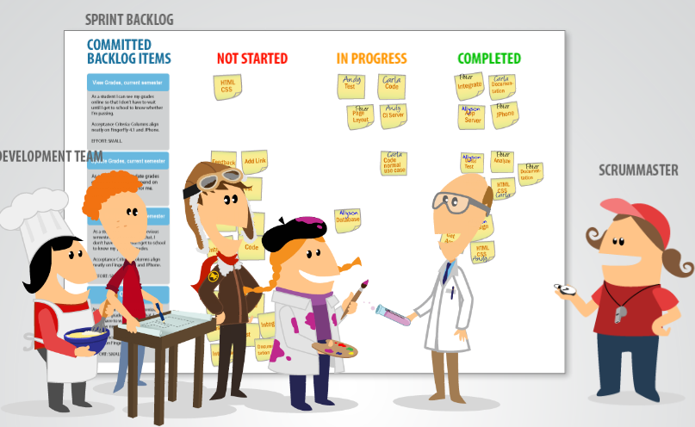
Scrum Meetings
Daily Scrum: It keeps the communication relevant to the work being done for the sprint
Scrum meetings are strictly time-boxed to 15 min
Discussions are brisk but relevant
All teams members attend scrum meetings
Each team member answers the following three questions:
What did you do yesterday?
What will you do today?
Are there any impediments in your way?
https://www.mountaingoatsoftware.com/agile/scrum/daily-scrum

Slide 18
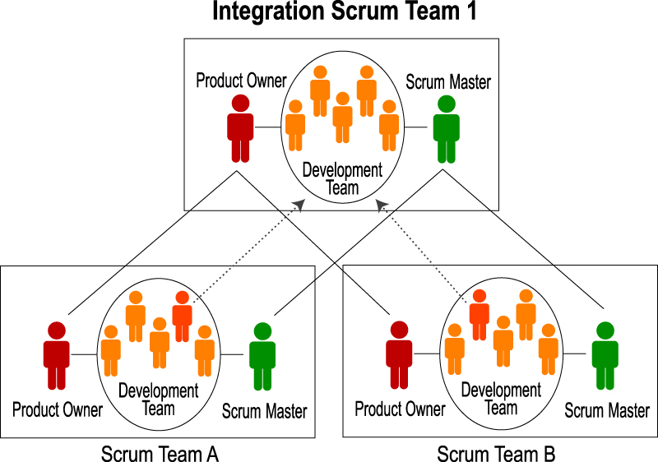
Scrum Communications
Communications:
Joint team daily standups
Use real-time video if the teams are close enough to each other
Phone line always on where team members can just talk
Dedicated office hours
During two week Sprints, the Scrum Team meets and communicates at least once daily, with a 10% of the Sprint spent on planning, demonstrating product and adapting and improving their process.
Further, there are daily Scrums, discussions with subject-matter expert, and design discussions and activities between team members
https://www.mitchlacey.com/blog/effective-communication-for-distributed-agilescrum-teams#sthash.cyAQa6M6.dpuf
http://agilemakingprogress.blogspot.com/2011/02/hyper-communication-scrums-secret-sauce.html

Slide 19
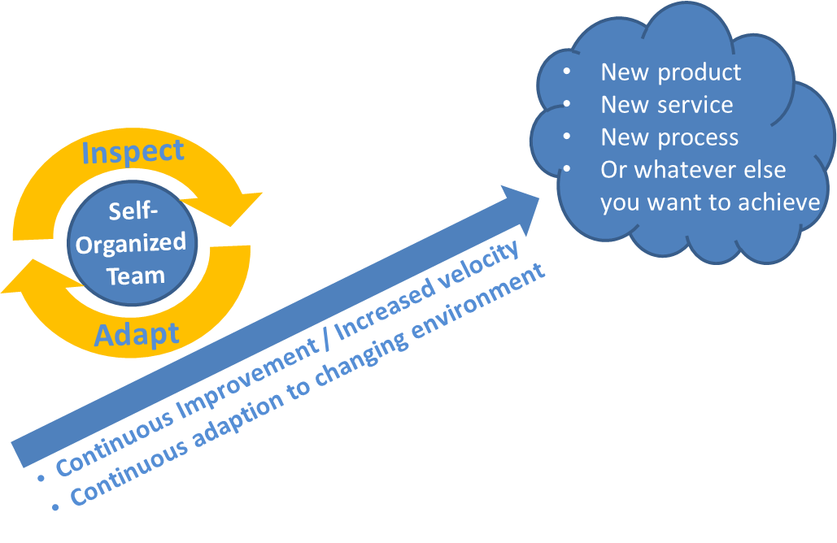
Empirical Process Control
Scrum is founded on empirical process control theory. Empiricism asserts that knowledge comes from experience and making decisions based on what is known.
Empirical process control relies on the three main ideas of transparency, inspection and adaptation.
Transparency:
Transparency allows all facets of any Scrum process to be observed by anyone. This promotes an easy and transparent flow of information throughout the organization and creates an open work culture.
http://www.scrumguides.org/docs/scrumguide/v1/Scrum-Guide-US.pdf#zoom=100

Slide 20
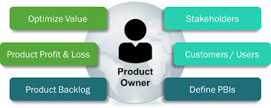
Empirical Process Control (Cont.)
Inspection:
Use of Scrum board and information radiators
Collection of feedback from customer and other stakeholders during the Develop Epic(s), Create Prioritized Product Backlog and Conduct Release Planning processes
Inspection and approval of the Deliverables by the Product Owner and the customer in the Demonstrate and Validate Sprint process
Adaptation:
Daily Standup Meetings
Constant Risk Identification
Change Requests
Scrum Guidance Body
Retrospect Sprint Meeting
Retrospect Project Meeting
http://www.scrumguides.org/docs/scrumguide/v1/Scrum-Guide-US.pdf#zoom=100
http://www.scrumstudy.com/scrum-empirical-process-control.asp

Slide 21
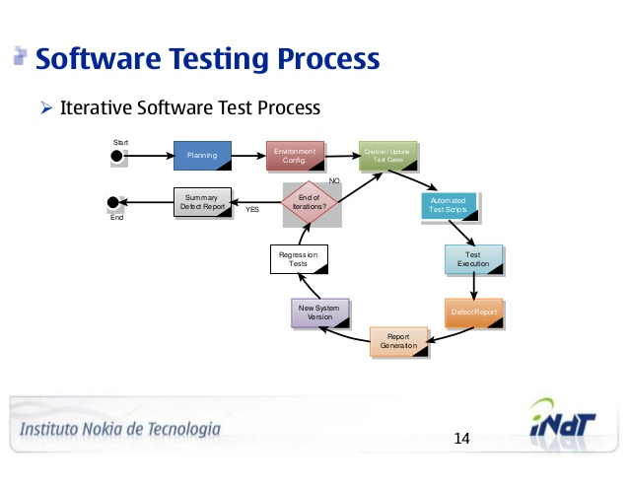
Scrum Software Testing
Testing is carried out by developer with Unit Test.
Product Owner is also frequently involved in the testing process during each sprint.
Some Scrum projects do have dedicated test teams depending on the nature and complexity of the project.
Identify the scenarios based on requirement document
Obtain sign-off of test scenario document from business owners
Write test cases for signed-off scenarios
For each sprint identify set of test cases.
http://www.guru99.com/scrum-testing-a-beginner-s-guide.html
https://anuradhaagarwal.wordpress.com/2010/07/20/scrum-testing-methodology/

Slide 22
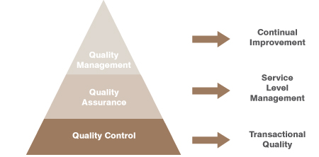
Software Quality Issues
Quality items Pileup
Module Integration Issues
Code Quality
Disruption in Team Work
Sprint Duration
Lack of Scrum Testing
Release Process
Backlog Management
http://www.ijser.org/researchpaper/Issues-and-Challenges-in-Scrum-Implementation.pdf

Slide 23
3. Scrum Team Members, Roles of Scrum Team Members

Slide 24
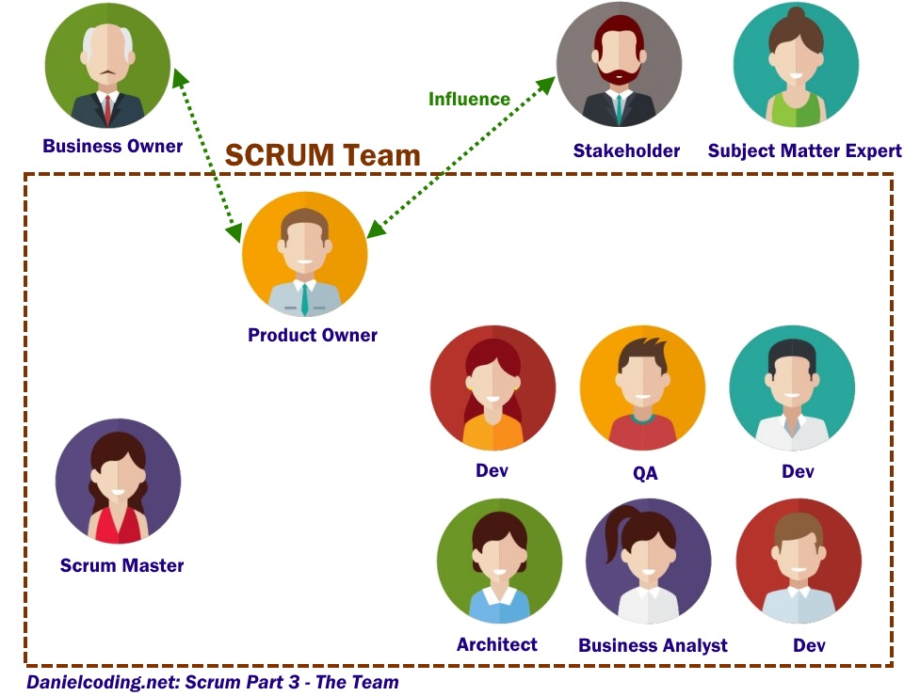
Scrum Team Members and Roles of Team Members
Scrum Team consists of:
Product Owner
Development Team
Scrum Master
Scrum Teams are self-organizing
and cross-functional
Self-organizing teams choose how best to accomplish their work, rather than being directed by others outside the team.
Cross-functional teams have all competencies needed to accomplish the work without depending on others not part of the team.
http://www.scrumguides.org/docs/scrumguide/v1/Scrum-Guide-US.pdf#zoom=100

Slide 25
Scrum Team Members and Roles of Team Members (Cont.)
Product Owner:
Shares vision of the Project
Responsible for maximizing the value of the product
Responsible for commercial success of the product
Must know what the customer needs
Translates requirements into the product backlog
Manages end-user (or customer) expectations and budget (ROI)
Maintains the Product Backlog
Prioritizes the functionalities to be built
Takes key decisions on behalf of the team or the project
Development Team:
Team members decide how to break work into tasks
How to allocate tasks to individuals, throughout the Sprint
Consists of professionals who do the work of delivering a potentially releasable increment of “Done” product at the end of each Sprint
Only members of the Development Team create the increment
https://www.cprime.com/resources/what-is-agile-what-is-scrum/

Slide 26
Scrum Team Members and Roles of Team Members (Cont.)
Scrum Master:
Scrum master is a coach not a boss
Has no authority over the team
Scrum master also makes sure the team is communicating well and using the framework to its greatest effect
Removing the barriers between the development Team and the Product Owner so that the Product Owner directly drives development
Teach the Product Owner how to maximize return on investment (ROI) and meet his/her objectives through Scrum
Improve the productivity of the development Team in any way possible
Improve the engineering practices and tools so that each increment of functionality is potentially shippable
Keep information about the Team’s progress up to date and visible to all parties
Must protect the Team from disturbance from other people by acting as the interface between the two
http://www.scrumguides.org/docs/scrumguide/v1/Scrum-Guide-US.pdf#zoom=100
https://www.cprime.com/resources/what-is-agile-what-is-scrum/

Slide 27
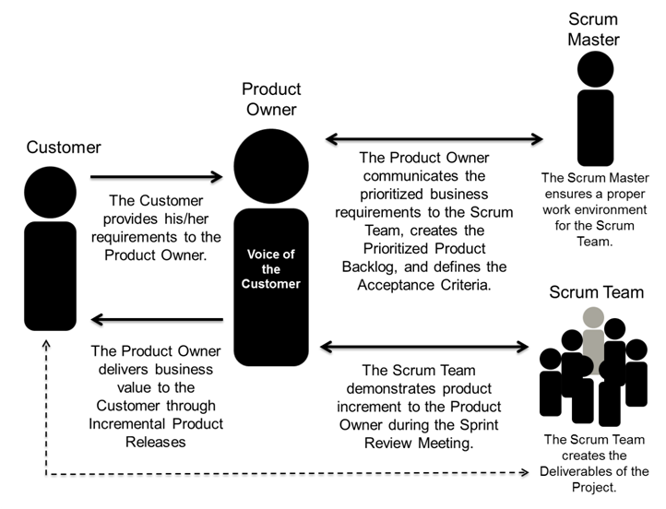
Scrum Team Members and Roles of Team Members (Cont.)
https://www.google.com/url?sa=i&rct=j&q=&esrc=s&source=imgres&cd=&cad=rja&uact=8&ved=0ahUKEwiU3_aSlu_MAhUm_IMKHXTuDTMQjRwIBw&url=http%3A%2F%2Fwww.scrumstudy.com%2Fblog%2Fscrum-project-roles-2%2F&psig=AFQjCNH4BOo8HdMsoLFOX4R4jfTDqCsBxQ&ust=1464057715273738

Slide 28
4. Sprint’s Fundamentals

Slide 29
Sprint Fundamentals
The heart of Scrum is a Sprint, a time-box of one month or less during which a “Done”, useable and potentially releasable product increment is created
Sprints contain and consist of the
Sprint Planning
Daily Scrums
Development work
Sprint Review
Sprint Retrospective
During the Sprint:
No changes are made that would endanger the Sprint Goal
Quality goals do not decrease
Scope may be clarified and re-negotiated between the Product Owner and Development Team as more is learned
https://www.scrumalliance.org/why-scrum/scrum-guide#sthash.7Z5Agm3N.dpuf

Slide 30
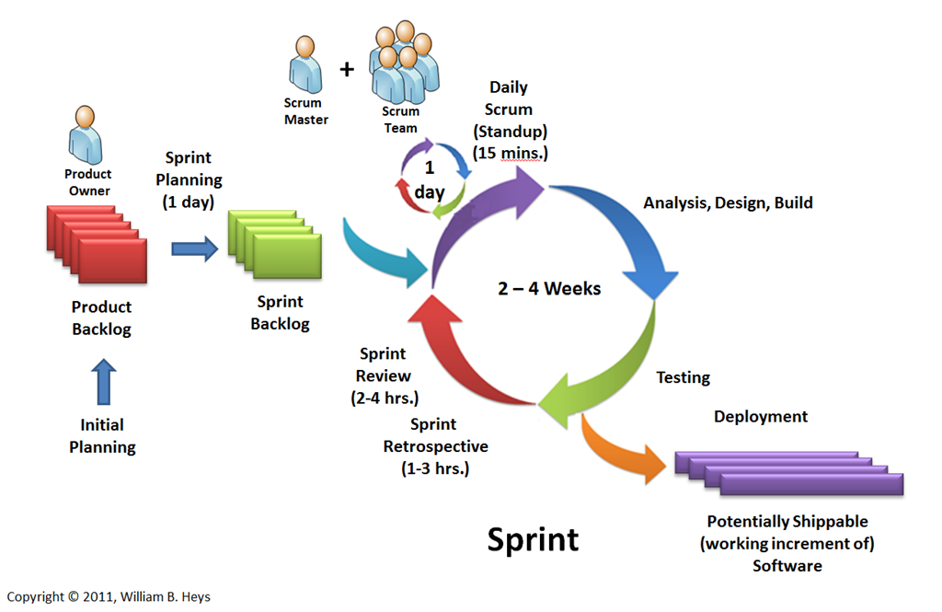
Sprint Fundamentals (Cont.)
https://blogs.msdn.microsoft.com/billheys/2011/01/18/branching-for-scrum/

Slide 31
Sprint Fundamentals (Cont.)
Each Sprint start with two planning sessions to define the content of the Sprint:
The WHAT-Meeting and the HOW-Meeting
The combination of these two meeting are also defined as Sprint Planning Meeting
In the WHAT-Meeting the Scrum Team commits to the User Stories from the Scrum Product Backlog and it uses a HOW-Meeting to break the committed User Stories into smaller and concrete tasks and then implementation begins
At the end of the Sprint, a Sprint Review Meeting is conducted to allow the Scrum Product Owner to check if all of the committed items are complete and implemented correctly
Additionally a Sprint Retrospective Meeting is conducted to check and improve the project execution processes: What was good during the Sprint, what should continue as it is and what should be improved
During the Sprint a short daily Standup-Meeting (Daily Scrum Meeting) is held to update the status of the items and to help self-organization of the team
http://wafimohtaseb.com/2012/02/25/what-is-scrum-part3-all-about-sprints/

Slide 32
5. Scrum Software Engineering Model

Slide 33
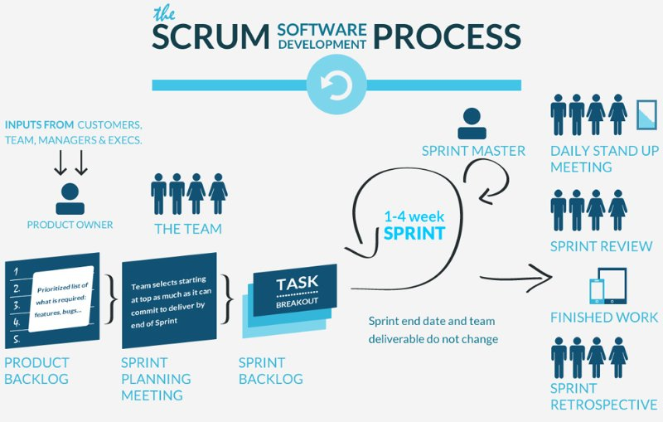
Scrum Software Engineering Model
Scrum is an iterative and incremental agile software development methodology for managing product development
It enables teams to self-organize by encouraging physical co-location or close online collaboration of all team members, as well as a daily face-to-face communication among a team members and disciplines in the project
https://www.gevme.com/blog/mudd-marrying-ux-design-and-development

Slide 34
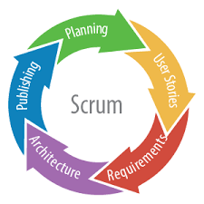
Scrum Software Engineering Model (Cont.)
Scrum consists of:
Initial appointment of a project manager called “scrum master”
Definition and prioritization of tasks to be done
Planning sessions for each task
Daily meetings among teams
Identification and evaluation of potential project risks and process pitfalls
Execution of projects in brief, high-intensity, frequent work sessions
Reviews of progress and evaluations of completed projects
Openness to constructive criticism and ideas for improvement
Defines “a flexible, holistic product development strategy where a development team works as a unit to reach a common goal”
https://www.gevme.com/blog/mudd-marrying-ux-design-and-development

Slide 35
6. Backlogs: sprint backlogs and product backlogs

Slide 36
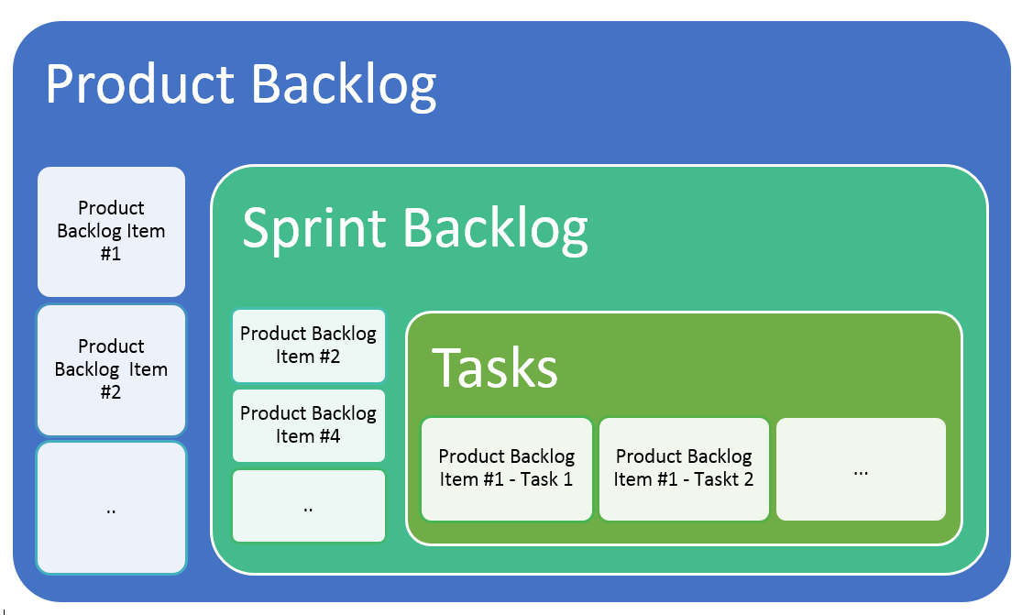
Backlogs
A backlog is a list of features or technical tasks which the team maintains and which, at a given moment are known to be necessary and sufficient to complete a project or a release:
If an item on the backlog does not contribute to the project’s goal, it should be removed.
On the other hand, if at any time a task or feature becomes known that is considered necessary to the project, it should be added to the backlog.
Backlogs:
Product Backlogs
Sprint Backlogs
https://www.scrumalliance.org/why-scrum/scrum-guide
http://guide.agilealliance.org/guide/backlog.html

Slide 37
Backlogs (Cont.)
Product Backlog:
An ordered list of everything that might be needed in the product and is the single source of requirements for any changes to be made to the product
The Product Owner is responsible for the Product Backlog
A Product Backlog is never complete
The Product Backlog is dynamic; it constantly changes to identify what the product needs
Requirements never stop changing, so a Product Backlog is a living artefact
Multiple Scrum Teams often work together on the same product. One Product Backlog is used to describe the upcoming work on the product
https://www.scrumalliance.org/why-scrum/scrum-guide
https://www.google.com/url?sa=i&rct=j&q=&esrc=s&source=images&cd=&cad=rja&uact=8&ved=0ahUKEwiTmaSrnu_MAhUFph4KHYETDpUQjRwIBw&url=http%3A%2F%2Fscrumreferencecard.com%2Fscrum-reference-card%2F&psig=AFQjCNE3TwcPuyndWiXee0-NonbE2nxu4Q&ust=1464059897788372

Slide 38
Backlogs (Cont.)
Sprint Backlog:
The Sprint Backlog is the set of Product Backlog items selected for the Sprint plus a plan for delivering the product increment and realizing the Sprint Goal
The Development Team modifies the Sprint Backlog throughout the Sprint
The Sprint Backlog is a forecast by the Development Team about what functionality will be in the next increment
Only the Development Team can change its Sprint Backlog during a Sprint
A subset of Product Backlog items, which define the work for a Sprint
Is created ONLY by Team members
Each Item has it’s own status
Should be updated every day
No more than 300 tasks in the list
https://www.scrumalliance.org/why-scrum/scrum-guide
https://www.google.com/url?sa=i&rct=j&q=&esrc=s&source=images&cd=&cad=rja&uact=8&ved=0ahUKEwiTmaSrnu_MAhUFph4KHYETDpUQjRwIBw&url=http%3A%2F%2Fscrumreferencecard.com%2Fscrum-reference-card%2F&psig=AFQjCNE3TwcPuyndWiXee0-NonbE2nxu4Q&ust=1464059897788372

Slide 39
7. Real-world Examples Of Scrum Method Application In SD Industry

Slide 40
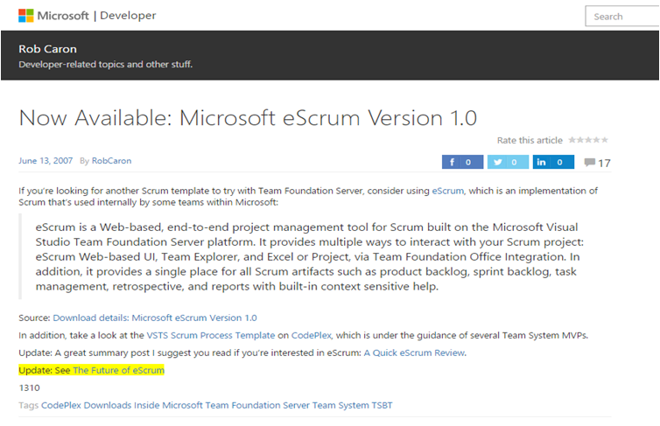
Scrum application in Microsoft
eScrum is a Web-based, end-to-end project management tool for Scrum built on the Microsoft Visual Studio Team Foundation Server Platform.
https://blogs.msdn.microsoft.com/robcaron/2007/06/13/now-available-microsoft-escrum-version-1-0/

Slide 41
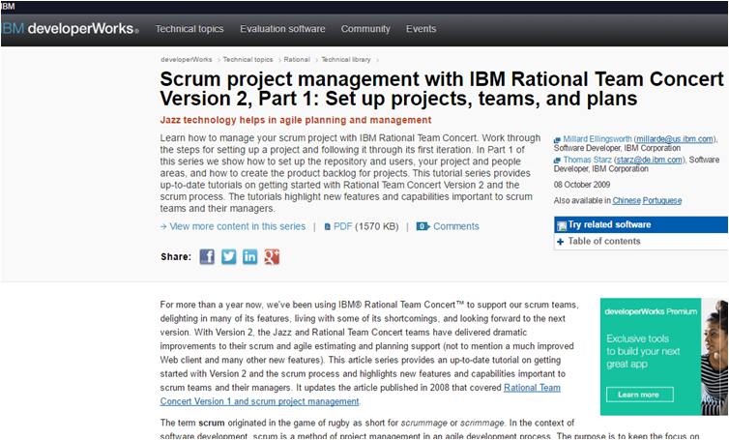
Scrum application in IBM
Helps in agile planning and management
IBM been using IBM® Rational Team Concert™ to support our scrum teams, delighting in many of its features
http://www.ibm.com/developerworks/rational/library/09/scrumprojectmanagementteamconcert-1/

Slide 42
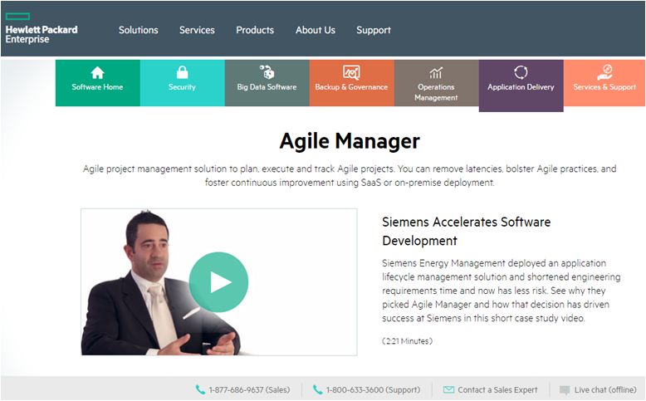
Scrum application in HP
Agile project management solution to plan, execute and track Agile projects.
You can remove latencies, bolster Agile practices, and foster continuous improvement using SaaS or on-premise deployment
http://www8.hp.com/us/en/software-solutions/agile-project-management-software-development/

Slide 43
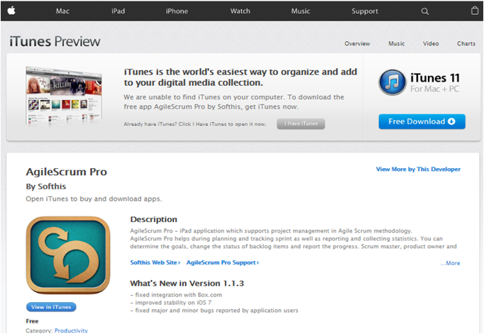
Scrum application in Apple
AgileScrum Pro - iPad application which supports project management in Agile Scrum methodology.
AgileScrum Pro helps during planning and tracking sprint as well as reporting and collecting statistics
https://itunes.apple.com/us/app/agilescrum-pro/id547660657?mt=8

Slide 44

Scrum application in Google
Google AdWords is an online advertising service that enables advertisers to compete to display brief advertising copy to web users, based in part on cookies, keywords, predefined by the advertisers, that might link the copy to the content of web pages shown to users
https://www.alexanderjsingleton.com/google-adwords-the-art-of-scrum-quintuple-constraint/

Slide 45
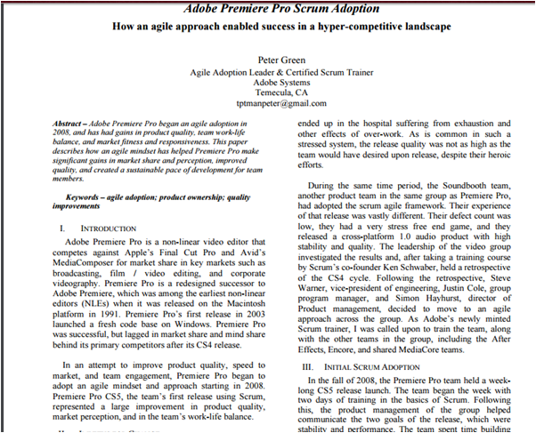
Scrum application in Adobe
Adobe Premiere Pro is a non-linear video editor that competes against Apple’s Final Cut Pro and Avid’s MediaComposer for market share in key markets such as broadcasting, film / video editing, and corporate videography
http://blogs.adobe.com/agile/files/2012/08/Adobe-Premiere-Pro-Scrum-Adoption-How-an-agile-approach-enabled-success-in-a-hyper-competitive-landscape-.pdf

Slide 46

Scrum application in Facebook
Facebook seems to almost go to great pains to not use the term "Agile" in its official engineering and software development communications
https://adtmag.com/articles/2011/01/14/how-facebook-does-agile.aspx

Slide 47
8. Scrum Method: SWOT Analysis

Slide 48
Scrum Method: SWOT Analysis
Strengths:
Scrum is very flexible to adapt
Scrum is simple framework
Agile scrum helps the company in saving time and money
Any mistakes can be easily rectified
Clear visibility of the project development
Iterative in nature
Daily meetings make it possible to measure individual productivity
Issues are identified well in advance through the daily meetings
It is easier to deliver a quality product in a scheduled time
Agile Scrum can work with any technology/ programming language
Team is given authority to make decisions
http://www.emilianosoldipmp.info/tag/swot-analysis/

Slide 49
Scrum Method: SWOT Analysis (Cont.)
Weaknesses:
Process is unstructured
May not be suitable for large scale organizations
Accurate documents are not present
There is no architecture based design for scrum.
Estimating project costs is difficult.
If the team members are not committed, the project will either never complete or fail.
Needs experienced people else project execution may not be completed on time.
Communication is critical.
If any of the team members leave during a development it can have a huge inverse effect on the project development
Project quality management is hard
http://www.emilianosoldipmp.info/tag/swot-analysis/

Slide 50
Scrum Method: SWOT Analysis (Cont.)
Opportunities:
For product-driven organizations, Scrum is a way to revolutionize how you do business
To increase productivity and to inspire commitment
Scrum features demonstrable progress realized through frequent, incremental production releases (Sprints).
It is ideal for start-ups trying to attract and maintain investors
Threats:
Threats are most likely to emerge from outside the team
Compliance and legal issues in large organizations are always looming
Security issues in large organizations are big because work product requires a security review
Jealously from non-scrum teams can be a threat
If an organization is not fully "Agile", or not all using Scrum, there's a perception that the Scrum team gets to do the best projects
http://www.emilianosoldipmp.info/tag/swot-analysis/

Slide 51
9. Scrum Tool: Version One

Slide 52
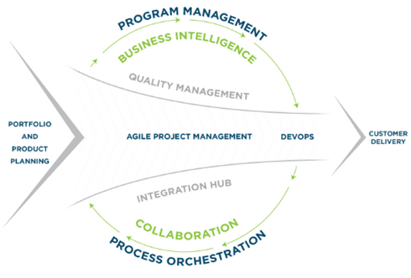
Scrum Tool: Version One
Version One is an all-in-one enterprise agile solution for software organizations scaling agile.
From discovery to delivery, Version One uniquely scales to any number of organizational levels and supports methodologies such as the scaled agile framework ®
Main features are:
Enterprise scalability
Management insight
Team simplicity
End-to-end visibility
All-in-One Agile ALM Platform
Product Leadership
Built for Agile
https://www.versionone.com/product/lifecycle/agile-tracking-tool/

Slide 53
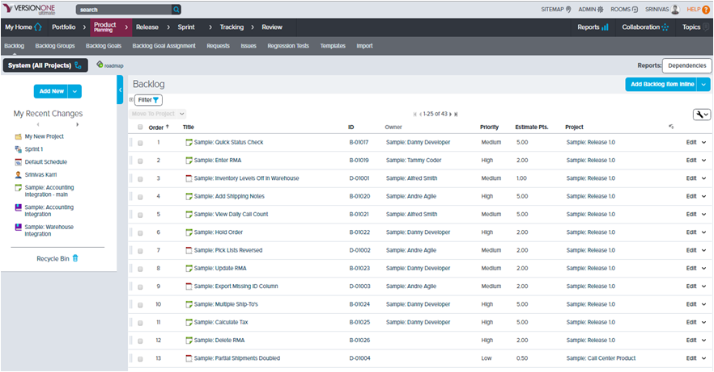
Scrum Tool: Version One (Cont.)
Product Planning and Backlog
https://www.versionone.com/product/lifecycle/agile-tracking-tool/

Slide 54
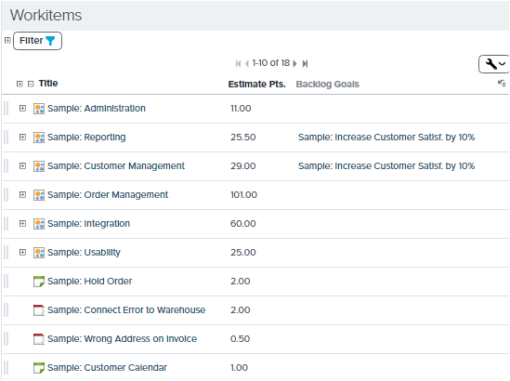
Scrum Tool: Version One (Cont.)
Workitems:
Contains the list of work items in the scrum
Estimated points for each work item will be given
Backlog goals also be mentioned for each work item
https://www.versionone.com/product/lifecycle/agile-tracking-tool/

Slide 55
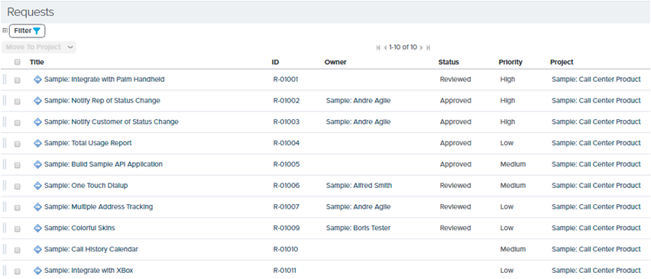
Scrum Tool: Version One (Cont.)
Requests:
Gives the list of all requests for the project
A request may have the Owner specified
Status of the request will be mentioned for each item.
Priorities are given to each request
https://www.versionone.com/product/lifecycle/agile-tracking-tool/

Slide 56
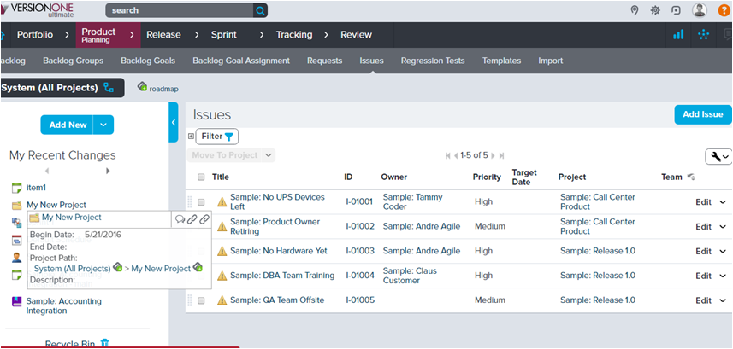
Scrum Tool: Version One (Cont.)
Issues:
Issues are raised by individual users
Priorities will be given to issue raised
We can reorder the issues
https://www.versionone.com/product/lifecycle/agile-tracking-tool/

Slide 57
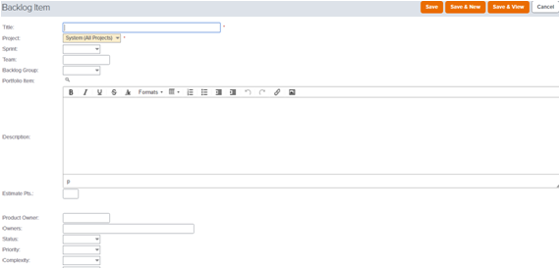
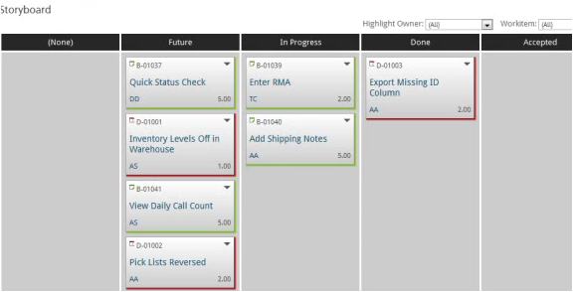
Scrum Tool: Version One (Cont.)
Backlogs:
We can add backlog items, user stories, epics and tasks
Update the existing tasks and issues
Assign priorities to backlogs
https://www.versionone.com/product/lifecycle/agile-tracking-tool/

Slide 58
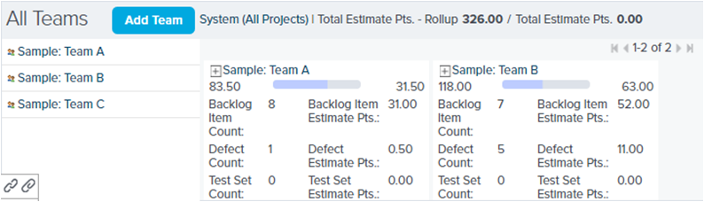
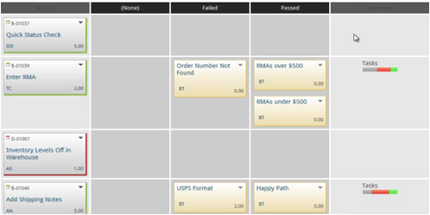
Scrum Tool: Version One (Cont.)
Release Planning:
For all the teams release planning is done
Estimates for the backlog items is given in the form of hours
https://www.versionone.com/product/lifecycle/agile-tracking-tool/

Slide 59
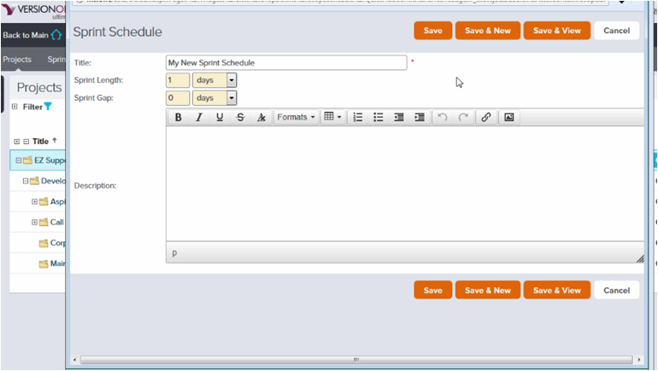
Scrum Tool: Version One (Cont.)
Sprint schedules are created by the scrum team
These include number of days and the gap of the sprints
https://www.versionone.com/product/lifecycle/agile-tracking-tool/

Slide 60
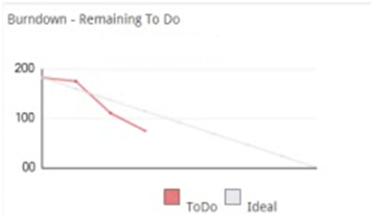
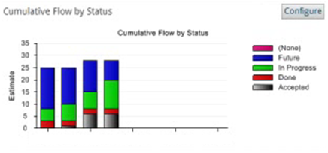
Scrum Tool: Version One (Cont.)
Task breakdown is done
Everyday this burndown in updated
Burndown graph is obtained based on the work logged
Cumulative flow status gives the status of project
Works that are done, in progress and those needs to be done in future
This gives the estimated hours for the tasks in different stages
https://www.versionone.com/product/lifecycle/agile-tracking-tool/

Slide 61
10. References Used

Slide 62
List of References Used and Useful Web-Based Resources
1.https://www.scrumalliance.org/why-scrum/scrum-guide#sthash.7Z5Agm3N.dpuf
2.http://www.scrumstudy.com/scrum-principles.asp#sthash.1RegxNXS.dpuf
3.https://www.google.com/url?sa=i&rct=j&q=&esrc=s&source=imgres&cd=&cad=rja&uact=8&ved=&url=http%3A%2F%2Fsparrow.pe.hu%2Fwhat-is-agile%2Fwhat-is-scrum%2F&psig=AFQjCNGt5iM0hnr7vTCE49-XmpYvyHdLxg&ust=1464030677125988
4.http://www.agilelearninglabs.com/resources/scrum-introduction/
5.https://www.gevme.com/blog/mudd-marrying-ux-design-and-development
6.https://www.scrumalliance.org/why-scrum/core-scrum-values-roles#sthash.KAS6gd6I.dpuf
7.https://blogs.msdn.microsoft.com/willy-peter_schaub/2010/04/27/basics-of-scrum-part-2-what-are-the-scrum-time-boxes-and-how-will-we-use-them-in-our-the-distributed-virtual-and-part-time-world/
8.http://www.slideshare.net/petebehrens/death-by-scrum-meeting
9.http://www.selectbs.com/process-maturity/what-is-scrum-development
10.http://www.scrumstudy.com/blog/7-cs-of-scrum/

Slide 63
List of References Used and Useful Web-Based Resources
11.http://agilemodeling.com/essays/prioritizedRequirements.htm#sthash.eq7TvmrY.dpuf
12.http://www.softwaretestinghelp.com/agile-scrum-methodology-for-development-and-testing/
13.VersionOne (for agile project management), http://www.versionone.com/agile-project-management-tools/ . Accessed April 7, 2014
14.VersionOne (for agile software development), http://www.versionone.com/agile-software/ . Accessed April 7, 2014
15.http://www.andreasphotiou.net/scrum-framework-the-scrum-team/
16.https://www.mountaingoatsoftware.com/agile/scrum/daily-scrum
17.http://www.scrumhub.com/scrum-guide/daily-standups/
18.https://www.scrumalliance.org/community/articles/2014/october/scrum-communication#sthash.zI1oKw6K.dpuf
19.https://www.mitchlacey.com/blog/effective-communication-for-distributed-agilescrum-teams#sthash.cyAQa6M6.dpuf
20.http://agilemakingprogress.blogspot.com/2011/02/hyper-communication-scrums-secret-sauce.html

